Slide 1
DBMS
SQL BASICS

Slide 2
RECAP
Constraints
  Create with constraints
  Alter with constraints

Slide 3
SET OPERATIONS

Slide 4
Set Operations
Set operators in MySQL allow you to manage and compare data sets.
Relational databases employ set operators to modify and compare data sets.
Simply put, a set operator creates a new set of data that satisfies particular requirements by combining or comparing two or more data sets.
SQL supports few Set operations which can be performed on the table data. These are used to get meaningful results from data stored in the table, under different special conditions.

Slide 5
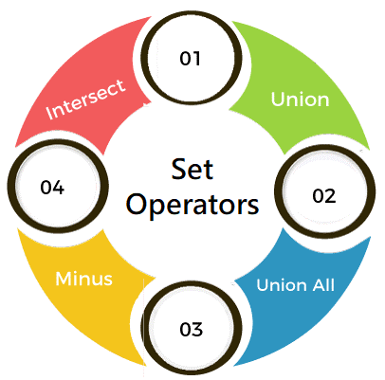
Common Set Operations
The frequently used to set operators in MySQL are:
  UNION
  UNION ALL
  INTERSECT
  EXCEPT or MINUS.
  These operations are used to manipulate and analyze data from different tables or queries, providing a way to merge, find commonalities, or determine differences between result sets.

Slide 6
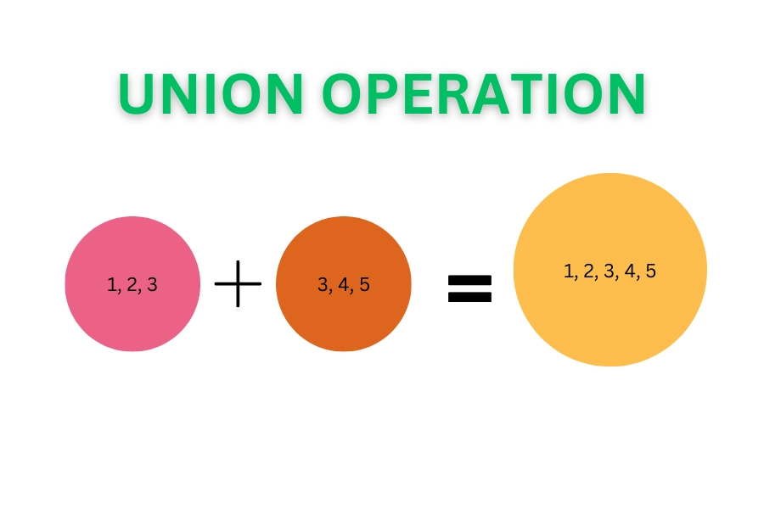

UNION
Combines the results of two or more SELECT statements into a single result set.
Removes duplicate rows from the combined result set.
In case of union, number of columns and datatype must be same in both the tables, on which UNION operation is being applied.

Slide 7
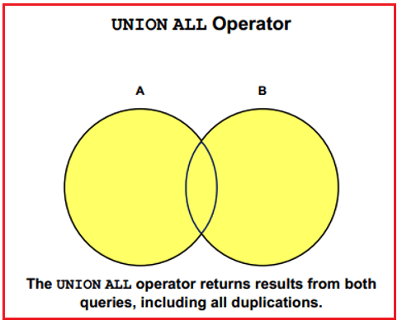
UNION ALL
Similar to UNION, but includes duplicate rows in the combined result set.

Slide 8
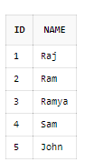



Example
select id from instructor union
select id from teaches;
INSTRUCTOR
select id from instructor union all
select id from teaches;
TEACHES

Slide 9
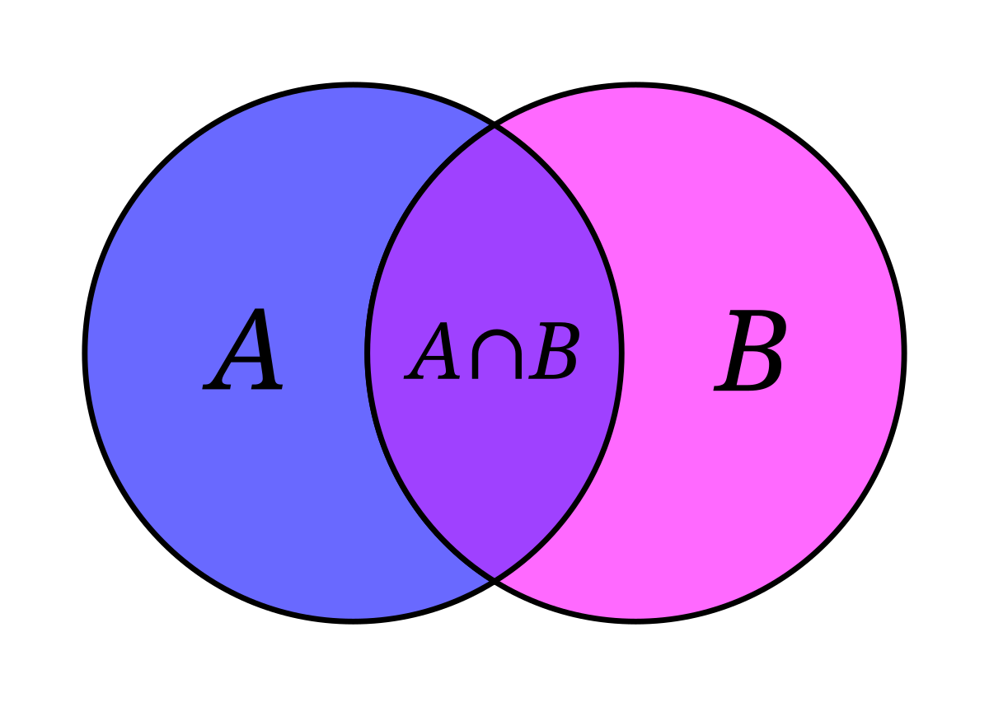

INTERSECT
Returns only the rows that are common to the result sets of two SELECT statements.
Requires that the number of columns and data types be compatible between the SELECT statements.
In case of Intersect the number of columns and data type must be same.

Slide 10
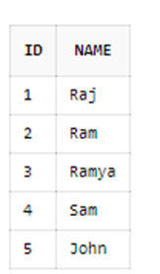

Example
INSTRUCTOR
select id from instructor intersect
select id from teaches;
TEACHES

Slide 11
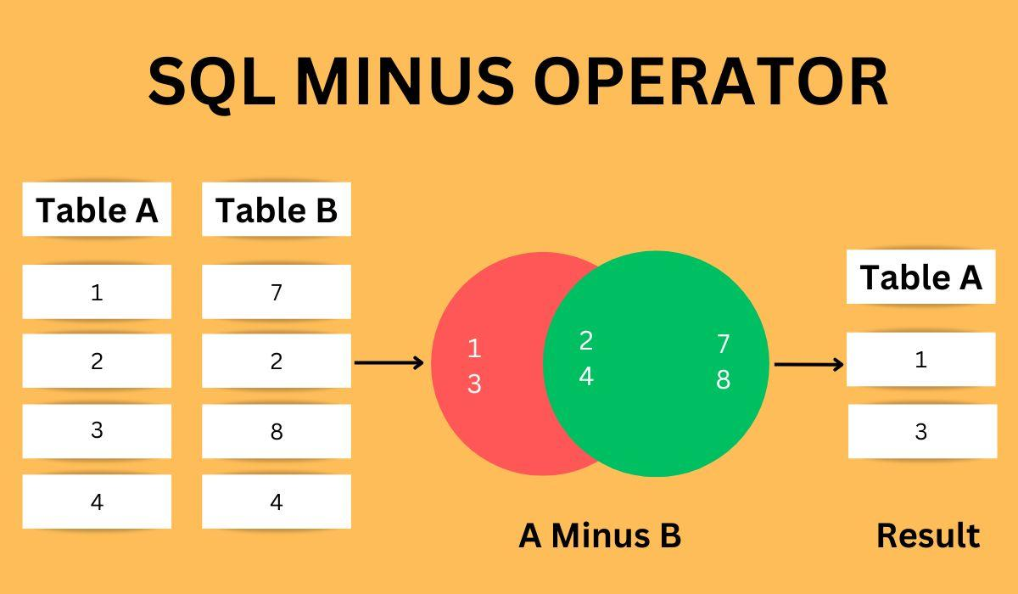
MINUS/EXCEPT
Returns the rows from the first SELECT statement that are not present in the second SELECT statement.
Similar to set difference in mathematics.
Requires that the number of columns and data types be compatible between the SELECT statements.
EXCEPT returns those rows from the first SELECT statement that are not present in the second.

Slide 12
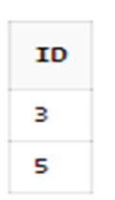
Example
select id from instructor
minus
select id from teaches;
INSTRUCTOR
TEACHES

Slide 13
Combining Set Operators
By mixing the set operators in various ways, you may design complicated queries that can help you extract useful insights from your data.
Assume that we have a table named customers as:
id | name | city
1 | Alice | Boston
2 | Bob | Miami
3 | Amanda | Austin
4 | David | Boston
5 | Emily | Miami

Slide 14
We want to combine the UNION and INTERSECT operators in MySQL with the same customers table.
Suppose we want to find the names of customers who either live in Boston or Miami and whose names start with the letter 'A’.
We can use the UNION and INTERSECT operators to achieve this.
Here's how the query would look:
SELECT name FROM customers WHERE city = 'Boston’
UNION
SELECT name FROM customers WHERE city = 'Miami'
INTERSECT
SELECT name FROM customers WHERE name LIKE 'A%';
name
Alice
David

Slide 15
String Functions

Slide 16
MySQL string functions
The most commonly used MySQL string functions that allow you to manipulate character string data effectively.
Name | Description
CONCAT | Concatenate two or more strings into a single string.
CONCAT_WS | Return a single string by concatenating multiple strings separated by a specified separator.
INSTR | Return the position of the first occurrence of a substring in a string.
LENGTH | Get the length of a string in bytes.
CHAR_LENGTH | Return the length of a string measured in characters.
LEFT | Get a specified number of leftmost characters from a string.
LOWER | Return a string converted to lowercase.
LOCATE | Return the position of a substring within a given string starting at a specified position.
LTRIM | Remove all leading spaces from a string.

Slide 17
REPLACE | Replace all occurrences of a substring in a string with a new one.
REPEAT | Repeat a string a specified number of time.
REVERSE | Reverse a string.
RIGHT | Get a specified number of rightmost characters from a string.
RTRIM | Remove all trailing spaces from a string.
SUBSTRING | Extract a substring starting from a position with a specific length.
SUBSTRING_INDEX | Return a substring from a string before a specified number of occurrences of a delimiter.
TRIM | Remove unwanted characters from a string.
FIND_IN_SET | Find a string within a comma-separated list of strings.
FORMAT | Format a number with a specific locale, rounded to the number of decimals.
UPPER | Convert a string to uppercase.

Slide 18
Example-CONCAT()
Example 1: Concatenating First and Last Name
  SELECT CONCAT(first_name, ' ', last_name) AS full_name
  FROM employees;
This joins the first_name and last_name columns with a space in between and gives the result as full_name.
Example2: To concatenate the values in the city and state columns into a single string:
  SELECT city, state, CONCAT(city, ',', state) city_state FROM
  customers;

Slide 19
CONCAT_WS
Simple CONCAT_WS function example
The following example uses the CONCAT_WS() function to concatenate two strings with a comma:
SELECT CONCAT_WS(',', 'John', 'Doe') full_name;
+-----------+
| full_name |
+-----------+
| John,Doe |
+-----------+
1 row in set (0.00 sec)

Slide 20
Some more examples
select substr(name,2,3) as short from instructor;
select length(name) from instructor;
select lower(name) from instructor;
select upper(name) from instructor;
select trim(name) from instructor;
Explore all other string functions
https://www.mysqltutorial.org/mysql-string-functions/

Slide 21
Example
CREATE TABLE employees (
id INT,
name VARCHAR(100),
email VARCHAR(100),
department VARCHAR(50)
);
INSERT INTO employees VALUES
(1, 'John Doe', 'john.doe@example.com', 'Sales'),
(2, 'Jane Smith', 'jane_smith@example.com', 'HR'),
(3, 'Mike Johnson', 'mike.j@example.com', 'IT');

Slide 22
Function | Description | Example & Result
LENGTH() | Length of string in bytes | SELECT LENGTH(name) FROM employees; → 8, 10, 12
CHAR_LENGTH() | Number of characters | SELECT CHAR_LENGTH(name) FROM employees;
CONCAT() | Join strings | SELECT CONCAT(name, ' - ', department) FROM employees;
CONCAT_WS() | Join with separator | `SELECT CONCAT_WS('
LOWER() | Convert to lowercase | SELECT LOWER(name) FROM employees;
UPPER() | Convert to uppercase | SELECT UPPER(name) FROM employees;
SUBSTRING() | Extract substring | SELECT SUBSTRING(email, 1, 10) FROM employees;
LEFT() | Left N characters | SELECT LEFT(name, 4) FROM employees;

Slide 23
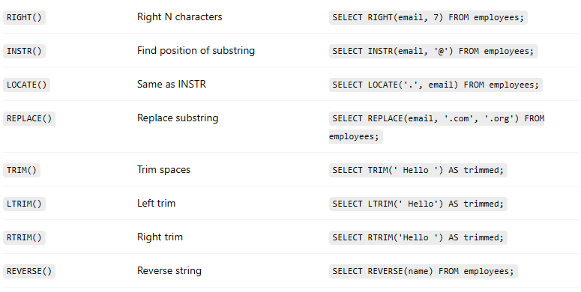

Slide 24
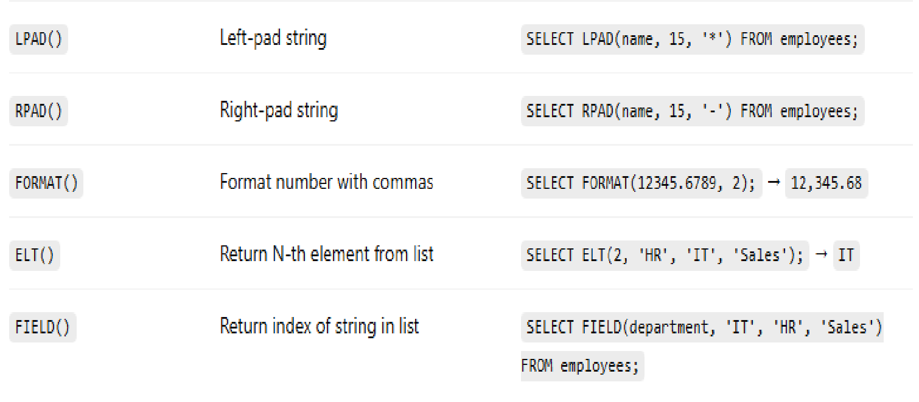

Slide 25
DATE AND TIME FUNCTIONS

Slide 26
Current Date and Time
Function | Description | Example
NOW() | Returns the current date and time | SELECT NOW();
CURDATE() | Returns the current date (no time) | SELECT CURDATE();
CURTIME() | Returns the current time (no date) | SELECT CURTIME();
UTC_DATE() | Returns the current UTC date | SELECT UTC_DATE();
UTC_TIME() | Returns the current UTC time | SELECT UTC_TIME();
UTC_TIMESTAMP() | Returns current UTC date and time | SELECT UTC_TIMESTAMP();

Slide 27
Date Extraction Functions
Function | Description | Example
YEAR(date) | Extracts the year | SELECT YEAR('2025-07-15'); → 2025
MONTH(date) | Extracts the month (1–12) | SELECT MONTH(NOW());
DAY(date) / DAYOFMONTH(date) | Extracts day of the month | SELECT DAY('2025-07-15'); → 15
HOUR(time) | Extracts the hour | SELECT HOUR(NOW());
MINUTE(time) | Extracts minutes | SELECT MINUTE(NOW());
SECOND(time) | Extracts seconds | SELECT SECOND(NOW());
DAYNAME(date) | Returns name of weekday | SELECT DAYNAME('2025-07-15'); → 'Tuesday'
MONTHNAME(date) | Returns name of month | SELECT MONTHNAME('2025-07-15'); → 'July'
WEEK(date) | Returns the week number | SELECT WEEK(NOW());

Slide 28
Date Arithmetic
Function | Description | Example
DATE_ADD(date, INTERVAL expr unit) | Adds interval | SELECT DATE_ADD('2025-07-15', INTERVAL 10 DAY);
DATE_SUB(date, INTERVAL expr unit) | Subtracts interval | SELECT DATE_SUB(NOW(), INTERVAL 1 MONTH);
ADDDATE(date, INTERVAL expr unit) | Synonym for DATE_ADD
SUBDATE(date, INTERVAL expr unit) | Synonym for DATE_SUB
DATEDIFF(date1, date2) | Difference in days | SELECT DATEDIFF('2025-07-15', '2025-07-01'); → 14
TIMEDIFF(time1, time2) | Difference in time | SELECT TIMEDIFF('12:30:00', '10:00:00'); → 02:30:00

Slide 29
Formatting and Conversion
Function | Description | Example
DATE_FORMAT(date, format) | Formats a date as string | SELECT DATE_FORMAT(NOW(), '%W, %M %e, %Y');
STR_TO_DATE(str, format) | Parses string to date | SELECT STR_TO_DATE('15-07-2025', '%d-%m-%Y');
UNIX_TIMESTAMP() | Returns current time as Unix timestamp | SELECT UNIX_TIMESTAMP();
FROM_UNIXTIME(unix_timestamp) | Converts Unix timestamp to datetime | SELECT FROM_UNIXTIME(1626357600);

Slide 30
Common Format Specifiers for DATE_FORMAT / STR_TO_DATE
Specifier | Meaning | Example
%Y | Year (4 digits) | 2025
%y | Year (2 digits) | 25
%m | Month (01–12) | 07
%c | Month (1–12) | 7
%d | Day of month (01–31) | 15
%e | Day of month (1–31) | 15
%H | Hour (00–23) | 14
%i | Minutes (00–59) | 45
%s | Seconds (00–59) | 30
%W | Weekday name | Tuesday
%M | Month name | July

Slide 31
Basics of the TIMESTAMP Data Type
Stores a date and time value.
Automatically converts between the session time zone and UTC (unlike DATETIME, which is time zone-neutral).
Common for tracking creation/update times in records.

Slide 32
Example
CREATE TABLE users (
id INT AUTO_INCREMENT PRIMARY KEY,
username VARCHAR(100),
created_at TIMESTAMP DEFAULT CURRENT_TIMESTAMP,
updated_at TIMESTAMP DEFAULT CURRENT_TIMESTAMP ON UPDATE CURRENT_TIMESTAMP
);

Slide 33
Get current timestamp
SELECT CURRENT_TIMESTAMP;
Convert Unix timestamp to date
SELECT FROM_UNIXTIME(1721046000);
Convert date to Unix timestamp
SELECT UNIX_TIMESTAMP('2025-07-15 10:00:00’);
Add/Subtract time from a timestamp
  -- Add 1 day
  SELECT TIMESTAMPADD(DAY, 1, '2025-07-15 10:00:00');
  -- Subtract 30 minutes
  SELECT TIMESTAMPADD(MINUTE, -30, '2025-07-15 10:00:00');

Slide 34
Difference between two timestamps
  SELECT TIMESTAMPDIFF(SECOND, '2025-07-15 10:00:00', '2025-07-15 10:30:00’);
Extract components from timestamp
  SELECT YEAR(created_at), MONTH(created_at), DAY(created_at), HOUR(created_at), MINUTE(created_at)FROM users;
Format a timestamp
  SELECT DATE_FORMAT(created_at, '%W %M %e, %Y at %h:%i %p')
  FROM users;

